Slide 1
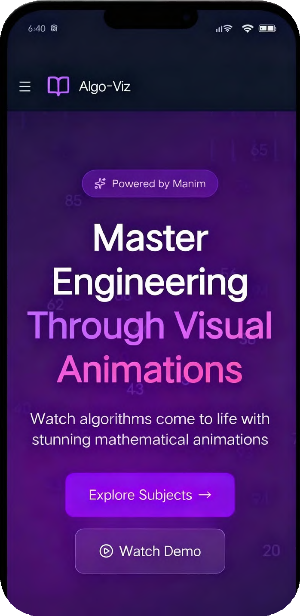


TechEd Stream
Sales Pitch
From Algoviz
1

Slide 2

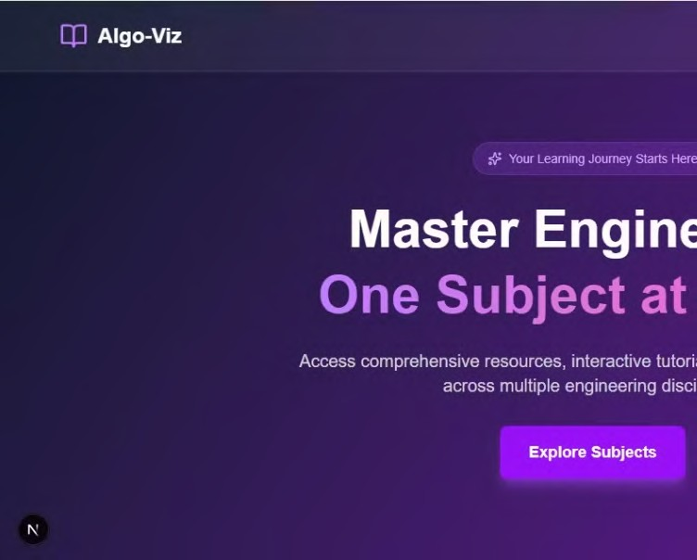
TechEd Stream
TechEd Stream
Master Engineering, Through Visual Animations
TechEd Stream is a web app that solves every engineering problem, regardless of the uniqueness of each question

Slide 3


Overview
TechEd Stream
There’s an engineering student, prepping hard for his semester exams.He thinks, “Best strategy—let me solve the Previous Year Questions (PYQs)!”
He solves them, but then gets stuck at the classic dilemma: “Are my answers correct or not?”
While it's best to drill down into the details in the following slides, if you would like to give your audience some context before diving in, this is the perfect place. You'll have plenty of opportunities to elaborate later.

Slide 4
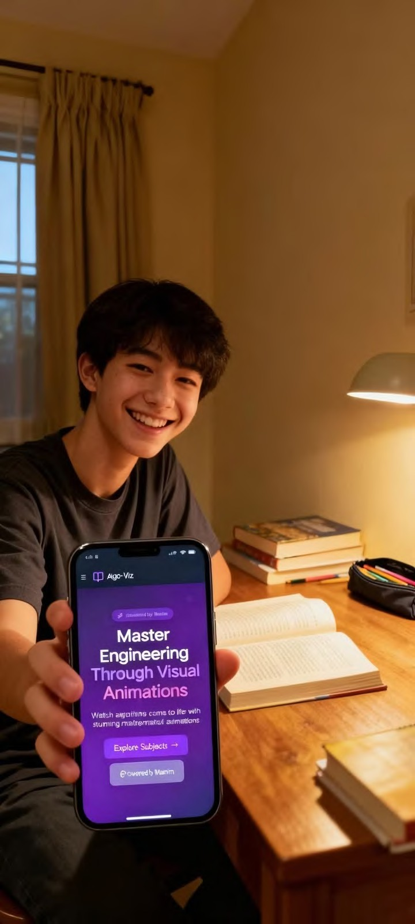
Overview
TechEd Stream
Then he discovers TechEd Stream.
Now he gets every PYQ problem broken down step-by-step, animated solutions, clear explanations, and understands not just the answer, but
the real concepts behind each question.

Slide 5



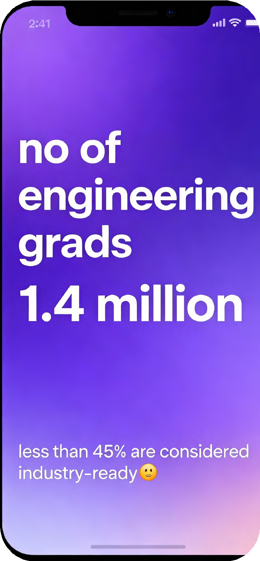



The Struggle with Traditional Learning
Engineering subjects often rely on static notes and theoretical diagrams
Limited visualization leads to poor concept understanding
2. Existing study platforms are generic – not tailored for every engineering Questions.
4. Students face di culty relating formulas to real-world applications
Problem

Slide 6





Market Research
TechEd Stream
Feature | NPTEL (IITs) | Coursera/Udemy | TechEd Stream
Interactive Simulation |  | (Video-Based) | ✅ (Core Feature)
Parameter-Driven Output | (Theoretical) | (No) | ✅(Instant Results)
Engineering- Speci c Focus | ✅ (Deep & Technical) | (Broad) | ✅ (Deep & Visualized)
Learning Model | Passive (Show) | Passive (Show) | ✅Active (Involve)

Slide 7










Market Research
TechEd Stream
3 78%
10
Million students in India struggle with visualization-based
learning
of students rely solely on notes or YouTube for concept learning
billion dollars is the number by which The Indian EdTech industry
is projected by 2025
TechEd Stream addresses a critical gap – interactive, subject-speci c visualization
The market is ripe for disruption with a solution that actively engages students rather than passively presenting information.

Slide 8
TechEd Stream
From formulas to future – we turn complexity into clarity."

Slide 9


Our Innovation: TechEd Stream
02
Solution

Slide 10

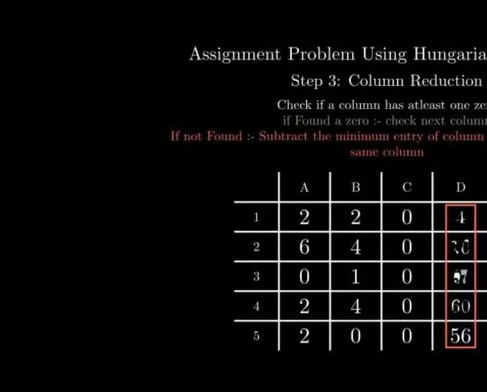
Features
TechEd Stream
1. Step-by-Step Animation
Design processes explained via detailed animations
Complex mechanisms and processes shown in motion

Slide 11

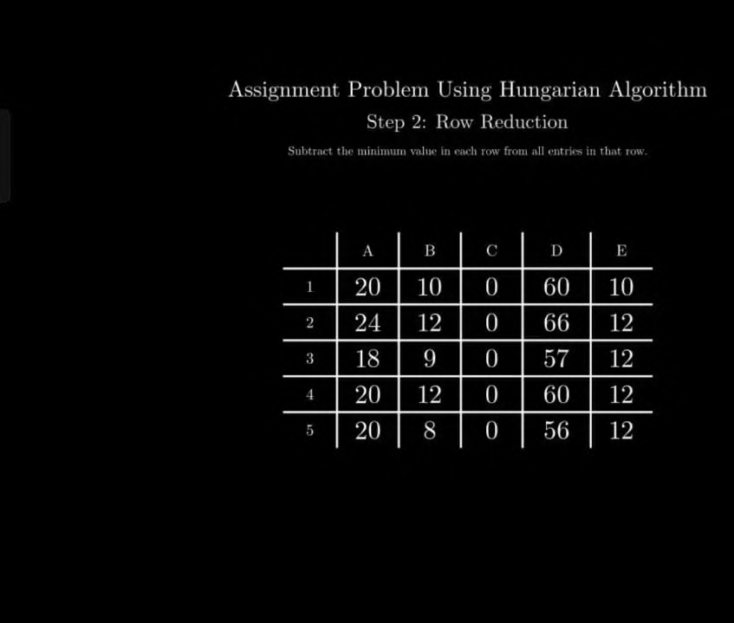
Features
TechEd Stream
2. Customizable Parameters
Change load, dimensions, or material properties
Get accurate results instantly Connect theory directly to practice

Slide 12
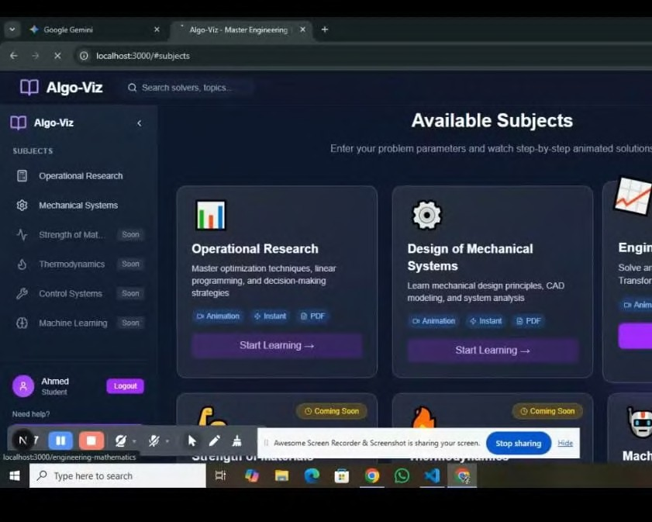
Features
TechEd Stream
3. Cloud-Based Access
No heavy software installation required Integrated Problem-Solving
Generates problems based on simulations Reinforces learning immediately

Slide 13
TechEd Stream
An Interactive Web-Based Learning Platform for Engineers We don't just show you, we involve you.

Slide 14

Product differentiators/ How is our product Novel
TechEd Stream
#1
Parameter-Driven Simulation
#2
Interactive Animations.
#3
First-of-Its-Kind Integration

Slide 15
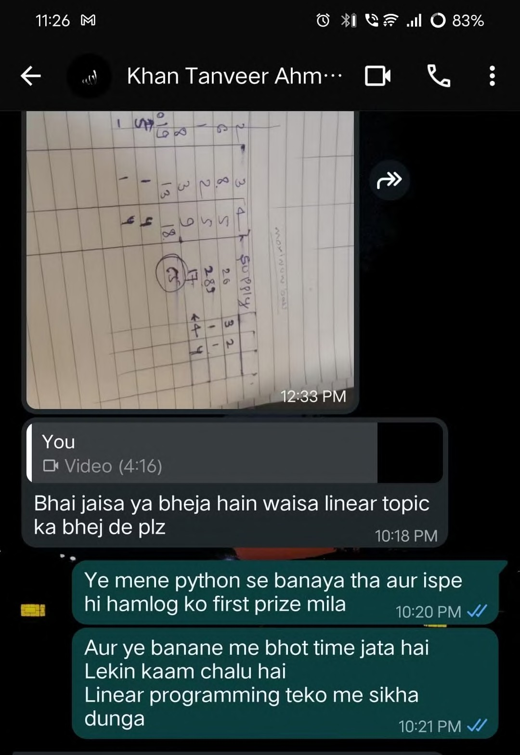

03 What does our Users say
We are conducting usability tests and surveys to validate that TechEd Stream: Directly improves understanding of complex concepts
Reduces study time through e cient visualization Increases engagement with interactive learning Early Testimonials:
"It helped me visualize beam de ection instantly!" – Engineering Student
"Makes complex topics like stress analysis much easier to grasp."
– Mechanical Engineering Student
"I wish our classroom tools were this interactive." – Faculty Reviewer
Case Study

Slide 16
TechEd Stream
"The web application was able to teach students the solution conceptua ly we l .

Slide 17
Business Model
TechEd Stream
Target Audience : B2C (Engineering Students) Secondary audience : B2B (Institutes)
Pricing
Budget | Economy | Premium
1 user 100 searches 2 subjects | 2 User 1000 searches 5 Subjects | 5 Users Unlimited Searches 18 subjects
300Rs | 500Rs | 1500Rs

Slide 18



Market Segmentation
04
Phase 1: Focus on Mechanical Engineering
Phase 2: Expand to Civil and Electrical Engineering Phase 3: Scale to all engineering branches

Slide 19
Market Size
04
~3 million Indian engineering students (immediate market)
1.5 million annual graduates (recurring market) Institutional market: 6,000+ engineering colleges in India

Slide 20
Roadmap
04
1: Prototype Development (3 months)
2: Beta Launch (2 months)
3: Expansion (3 months)
4: Public Launch
Next Steps

Slide 21

Funding Strategy
TechEd Stream
Seek incubation from college startup platforms
Apply for seed funding from EdTech investors
Explore government grants for education innovation
TechEdStream By
Algoviz

Slide 22

Our Team
TechEd Stream
Ahmed Momin
Developer & UI Designer Expertise in frontend development
Shaikh Mehboob
Testing & Deployment
Ensuring quality and seamless deployment
Khan Muzammil
Project Lead & Content Strategist Driving vision and content development
Qamar Kazi
Simulation Logic Developer
Engineering the parameter-driven algorithms

Slide 23
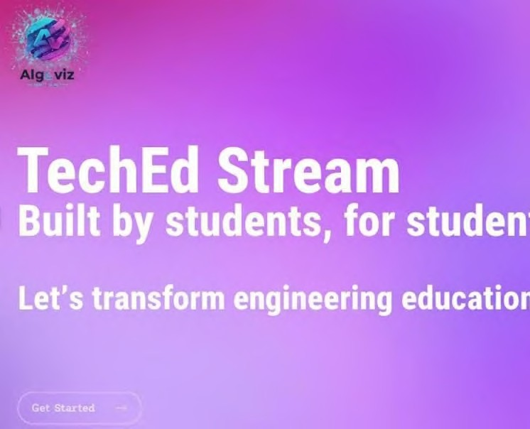
TechEd Stream
Thank you.

Slide 24

Ÿ Piîch
Wunt to moke o presentution
like this oneč
Start with a fully customizable template, create a beautiful deck in minutes, then easily share it with anyone.

